Slide 1
American Car License Plate Recognition
EECE7398 Advances in Deep Learning – Final Presentation
Zehua Liu
Xu Liang
Hao Lei

Slide 2
Challenges？
➔ Predecessors’ works mainly include license plates from China, South Korea, European countries, Japan, Brazil, etc. In those countries, the license plates themselves do not have complicated background and the patterns are consistent through out the whole county. And compared with the US, the datasets of these license plates are much larger, thereby reducing the difficulty of direct recognition.
➔ Due to the lack of dataset, we decided to avoid using a very limited number of data to train a powerful net, like Yolo-CNN, to do the whole thing once for all, but to split the whole process into small problems and use simple-structure nets to conquer each.

Slide 3
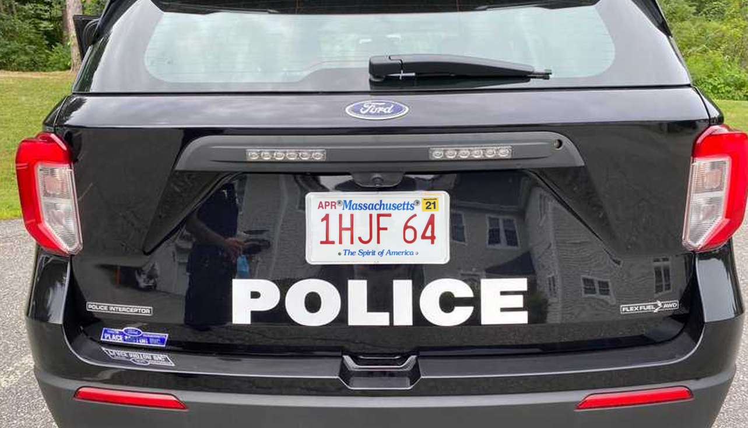
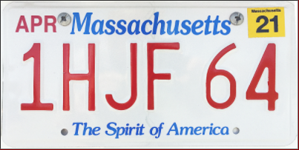


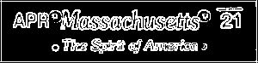
Overview
Rectangle
detection
candidates
Size/Shape Filter
PVN
Plate Validation Net
Extract top and bottom parts
- Grayscale
- Edge detection - Binarization
1 H J F 6 4
CRN
Char Recognition Net
Character segmentation
Serial extraction
MA
SRN
State Recognition Net
RGB Info

Slide 4
Road Map
Dataset Manufacturing
Rectangle Detection & Plate Validation
State Recognition & Serial Extraction
Character Segmentation & Recognition
Future Work

Slide 5
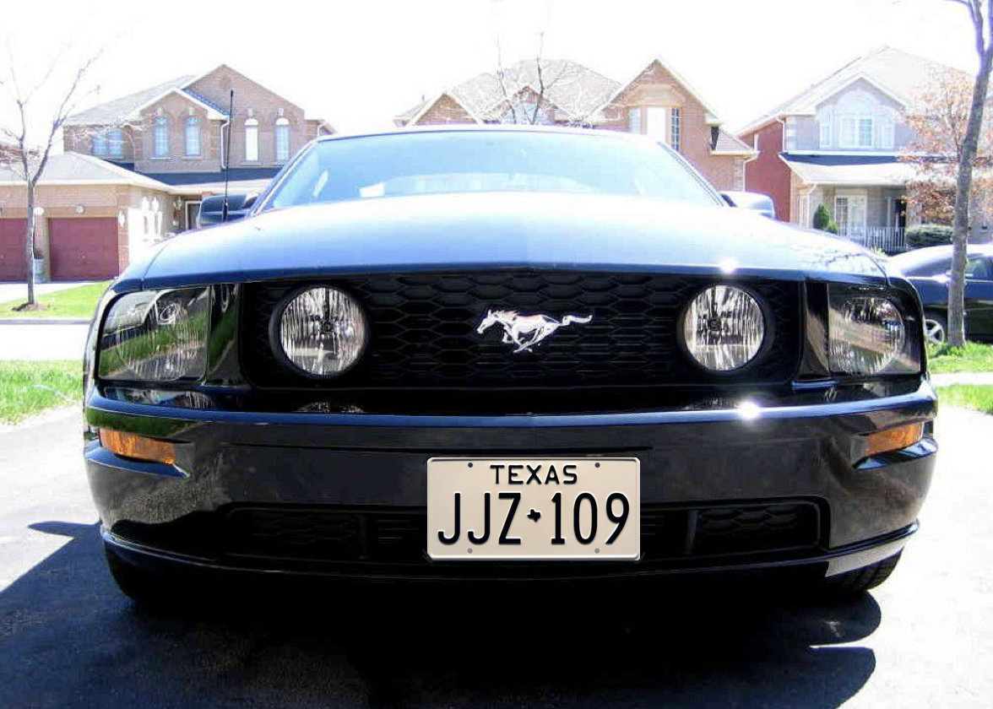
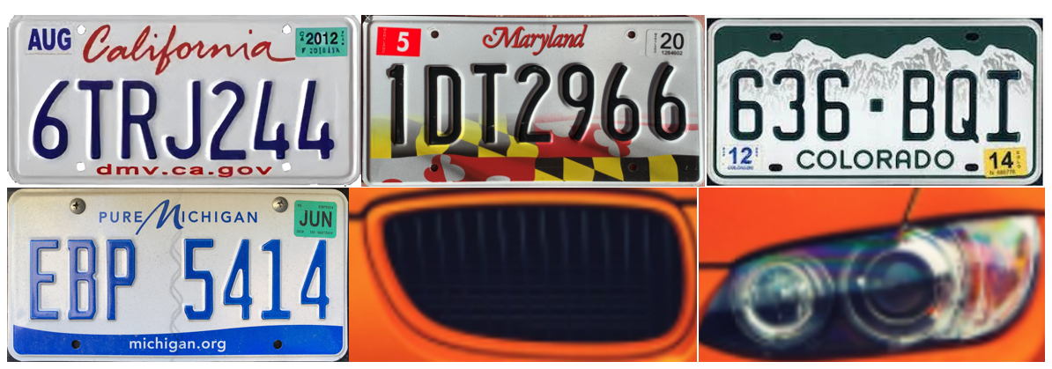
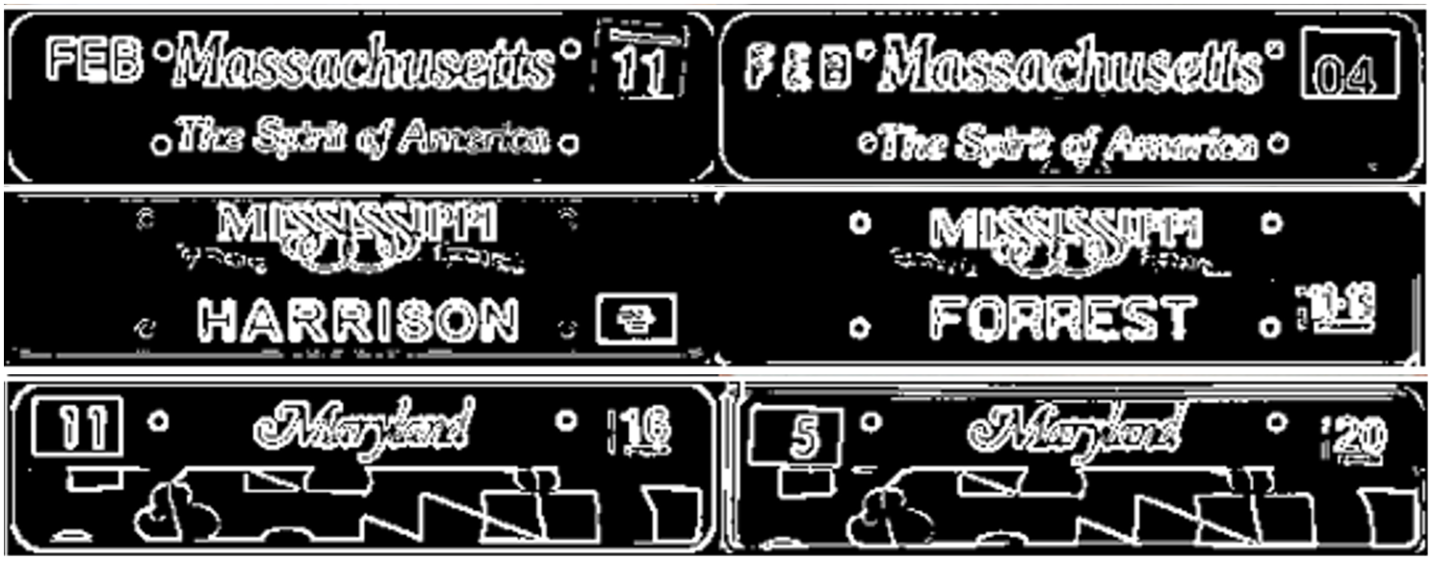
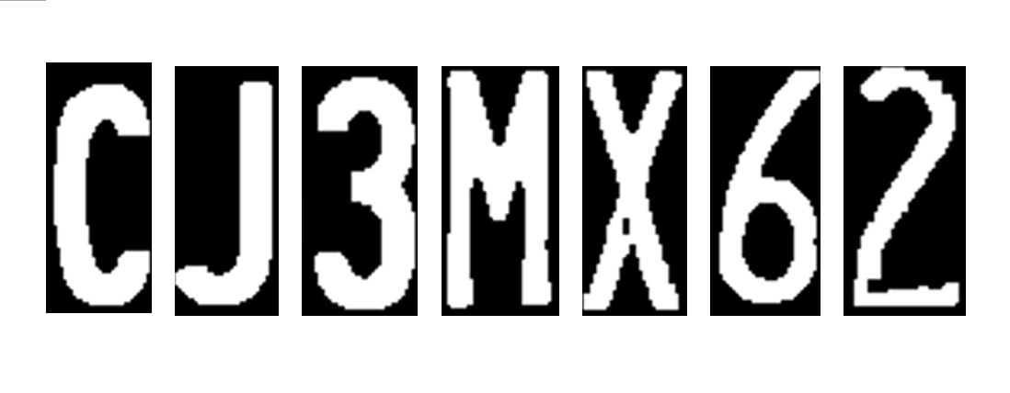
Dataset Manufacturing
Only used for overall test
Derive
PVN
Plate Validation Net
SRN
State Recognition Net
CRN
Char Recognition Net

Slide 6
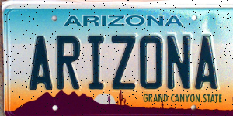
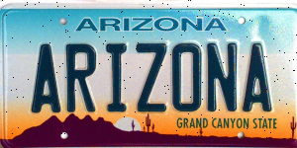

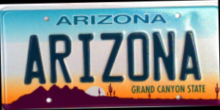
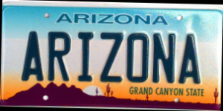
Dataset Manufacturing
No perfect clarity?
No perfect angle?
Add random noise
Add rotations

Slide 7
Road Map
Dataset Manufacturing
Rectangle Detection & Plate Validation
State Recognition & Serial Extraction
Character Segmentation & Recognition
Future Work

Slide 8
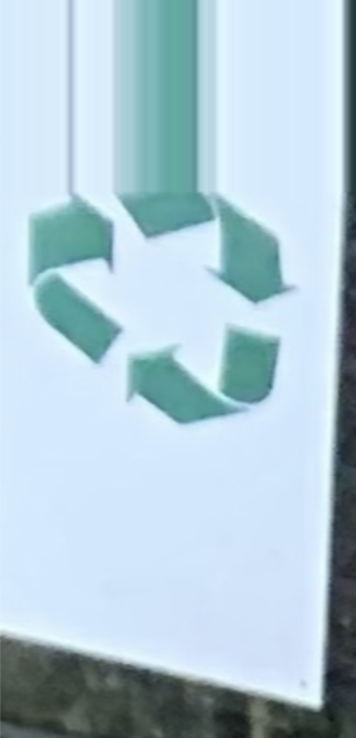
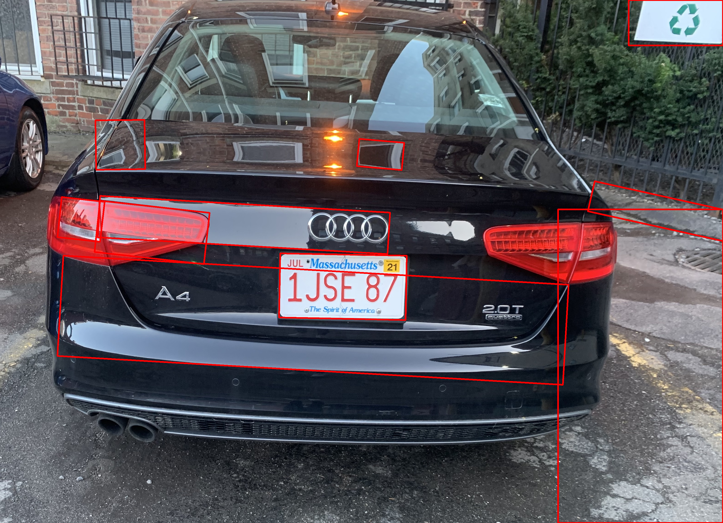
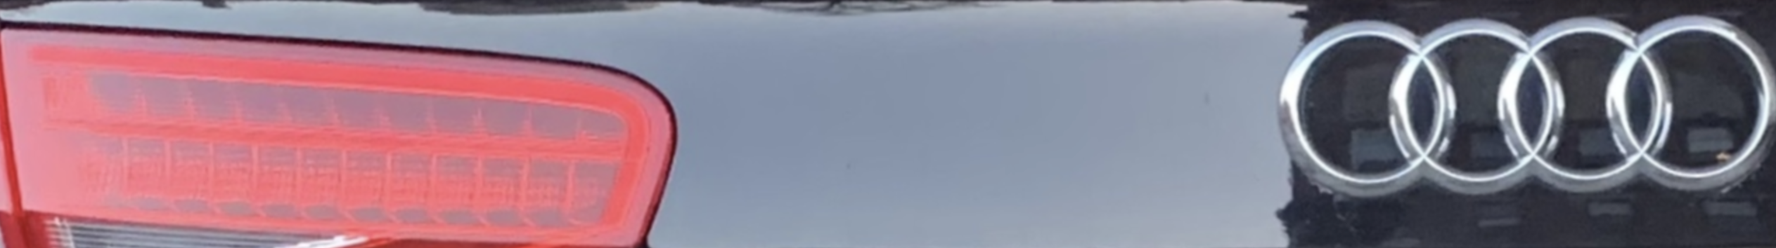
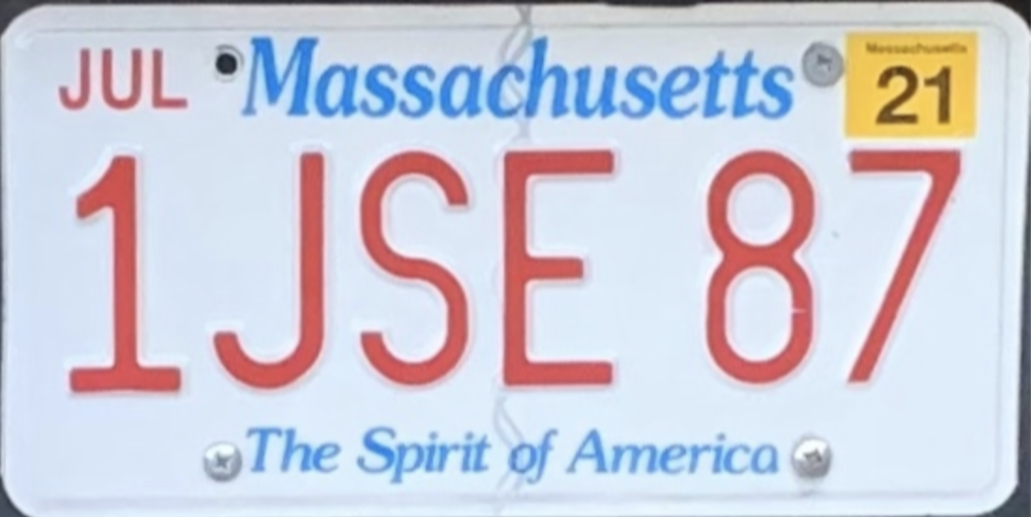
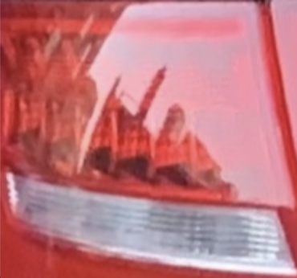
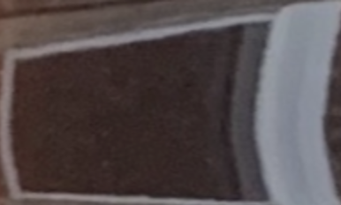
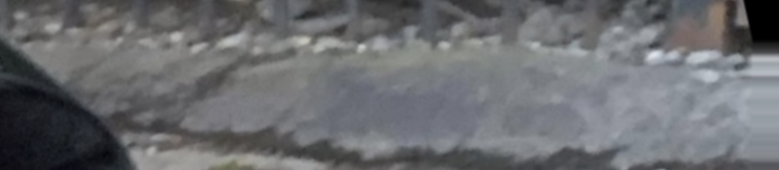
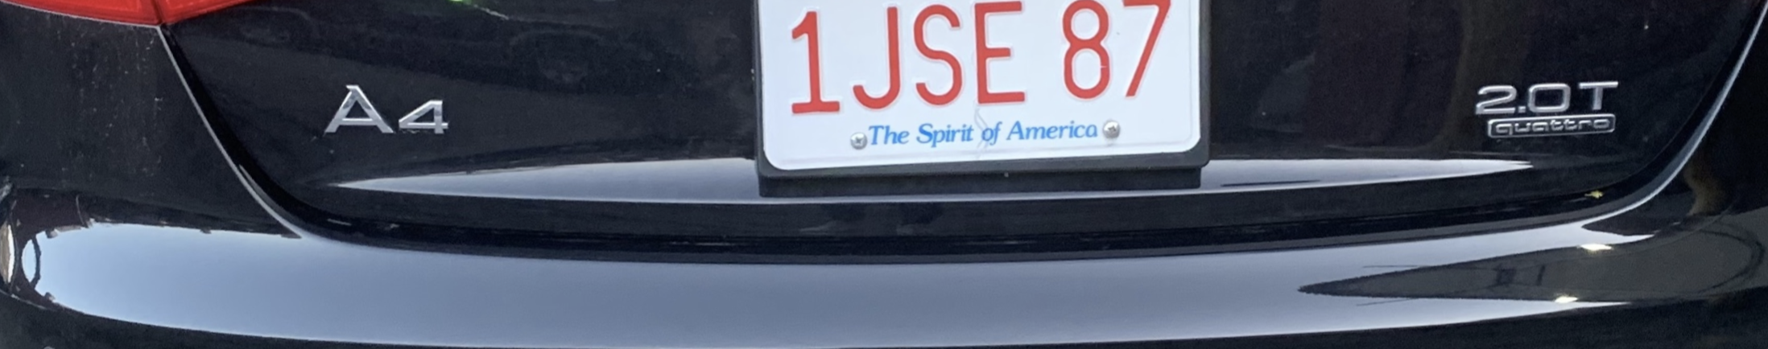
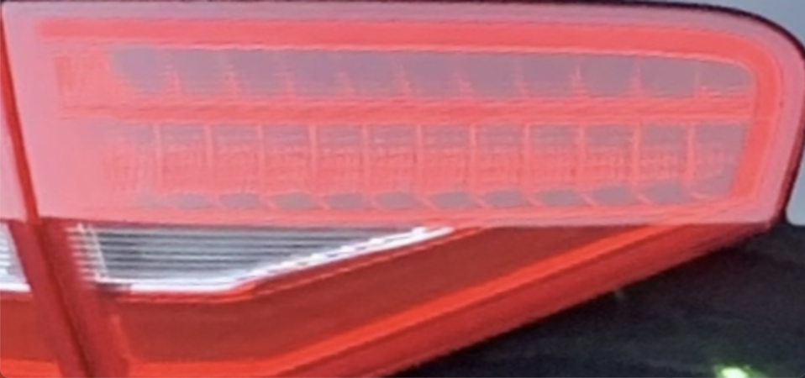
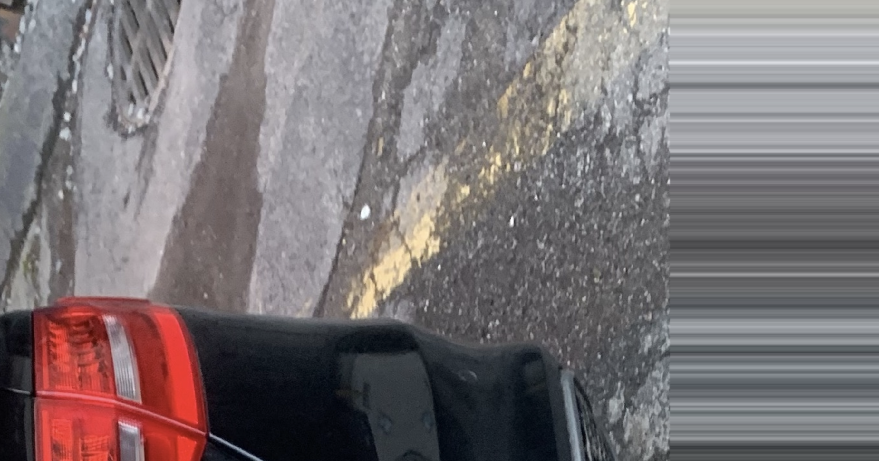
Rectangle Detection and Plate Validation
Find minimum enclosing rectangles with the rational size
Straighten and crop the rectangle images

Slide 9
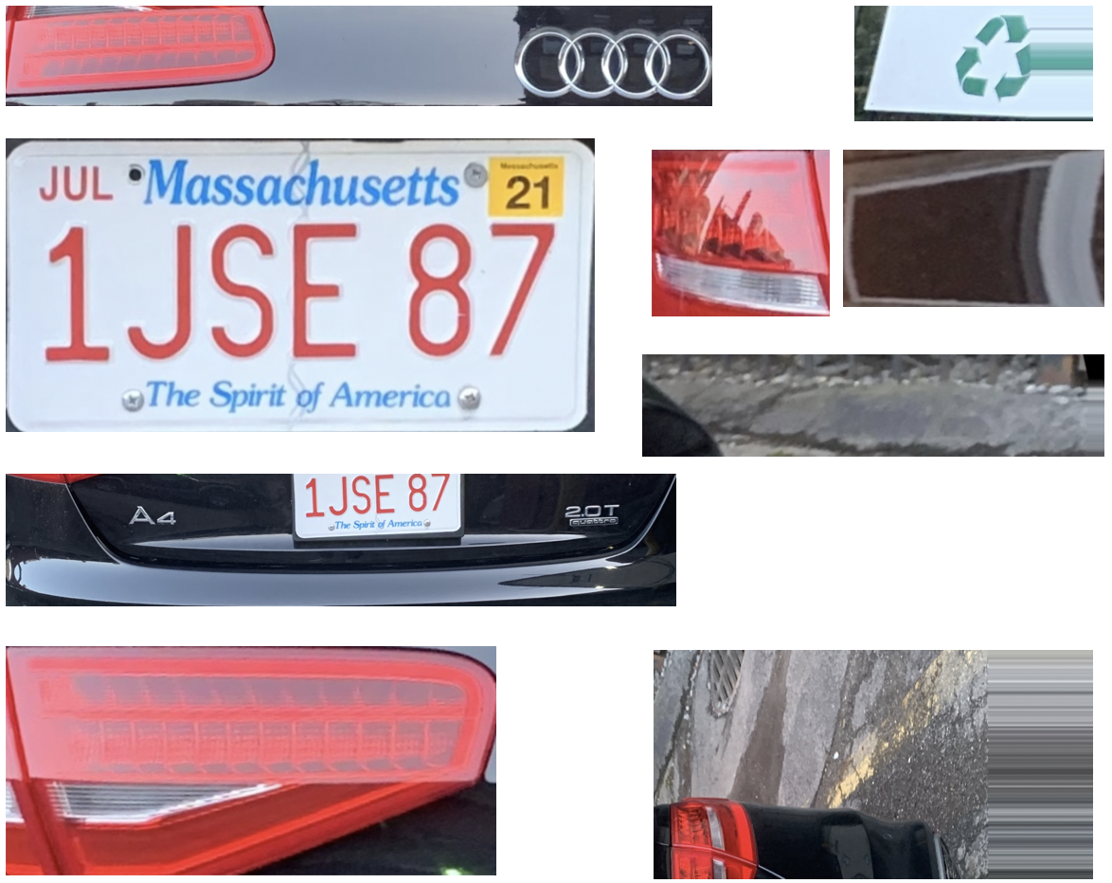
Rectangle Detection and Plate Validation
Candidates
The Image verified as True by PVN
PVN
Plate Validation Net

Slide 10
Road Map
Dataset Manufacturing
Rectangle Detection & Plate Validation
State Recognition & Serial Extraction
Character Segmentation & Recognition
Future Work

Slide 11
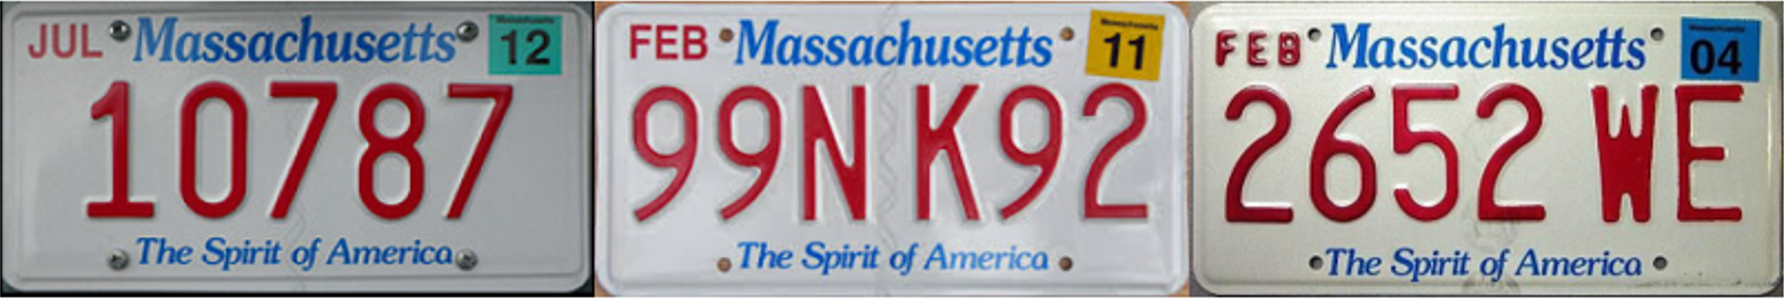
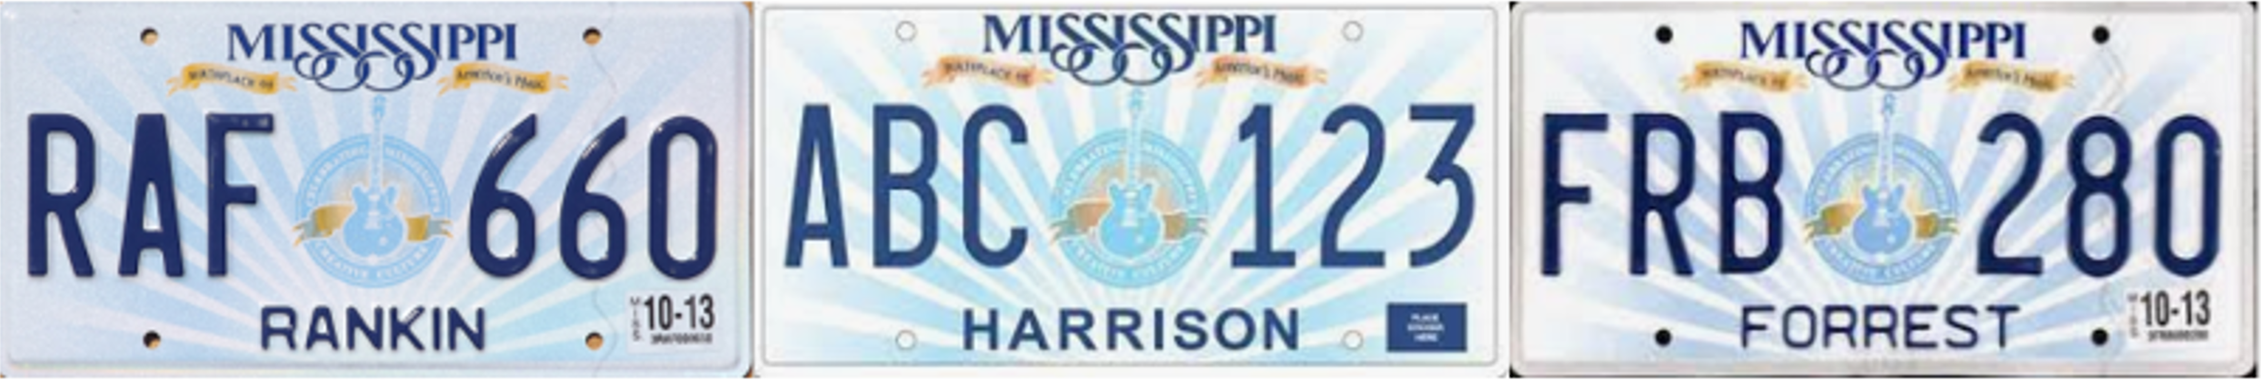
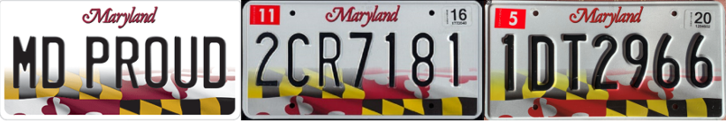
State Recognition and Serial Extraction
Three important properties
Format & Pattern are stable
Serial colors are consistent
Serial colors are different from the background

Slide 12
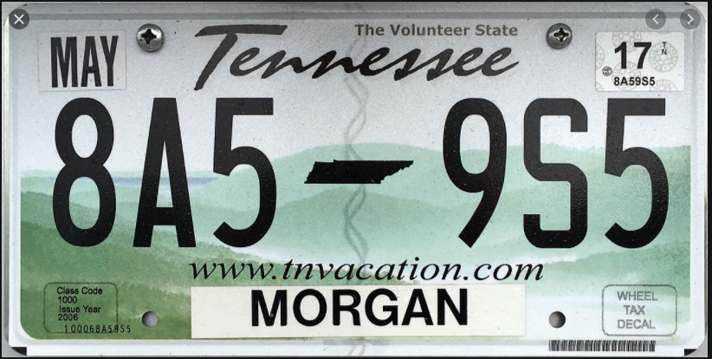
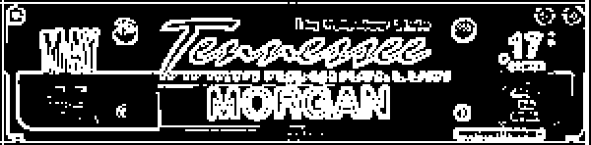
State Recognition and Serial Extraction
State features area
Edge detection & binarization
> 127 ➔ 255
<= 127 ➔ 0
SRN
State Recognition Net
Result: TN
Feature image

Slide 13

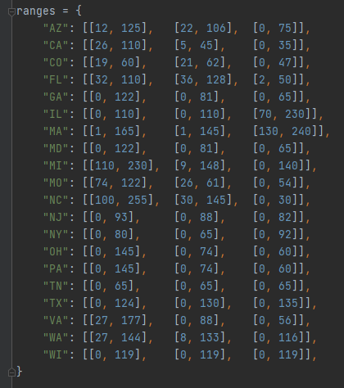
State Recognition and Serial Extraction
Serial area
TN: [[0, 65], [0, 65], [0, 65]]
Look up to
Result: TN
State-color range table

Slide 14
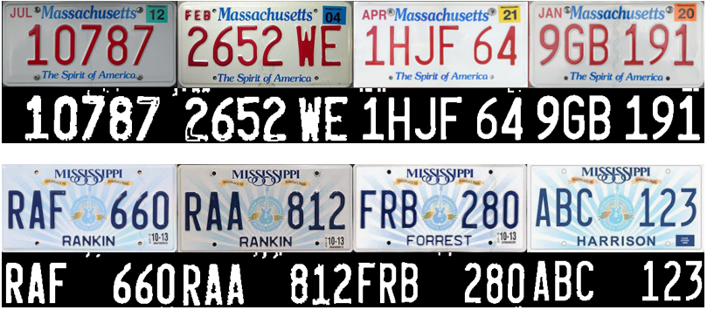
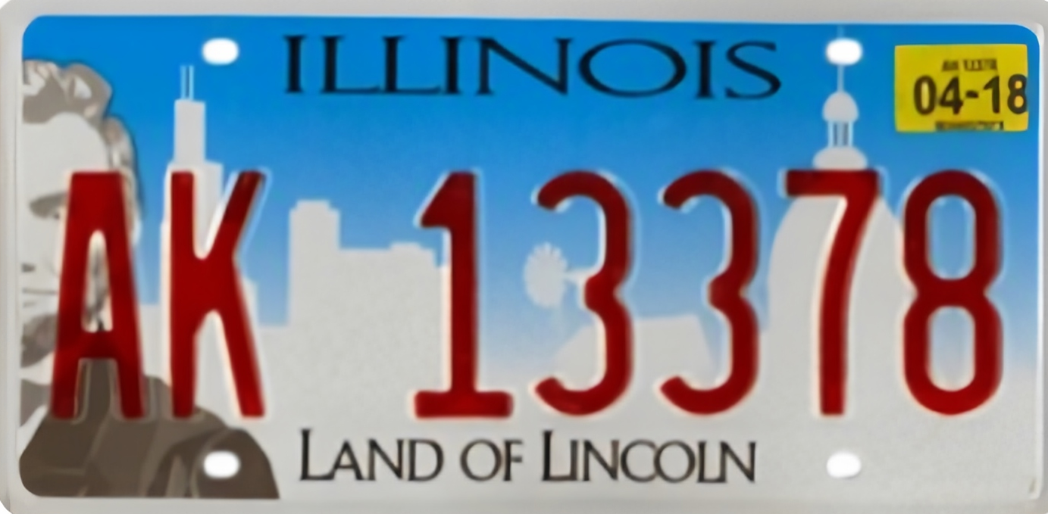

State Recognition and Serial Extraction
New and old license plates?
Different illumination?
Properly widened RGB range
Too-wide RGB range

Slide 15
Road Map
Dataset Manufacturing
Rectangle Detection & Plate Validation
State Recognition and Serial Extraction
Character Segmentation & Recognition
Future Work

Slide 16

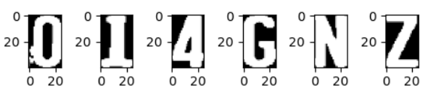
Character Segmentation and Recognition
Find the bounding rectangle
Crop the rectangle image
Normalize the size
CRN
Char Recognition Net
O or 0 ?
Result: 014GNZ

Slide 17
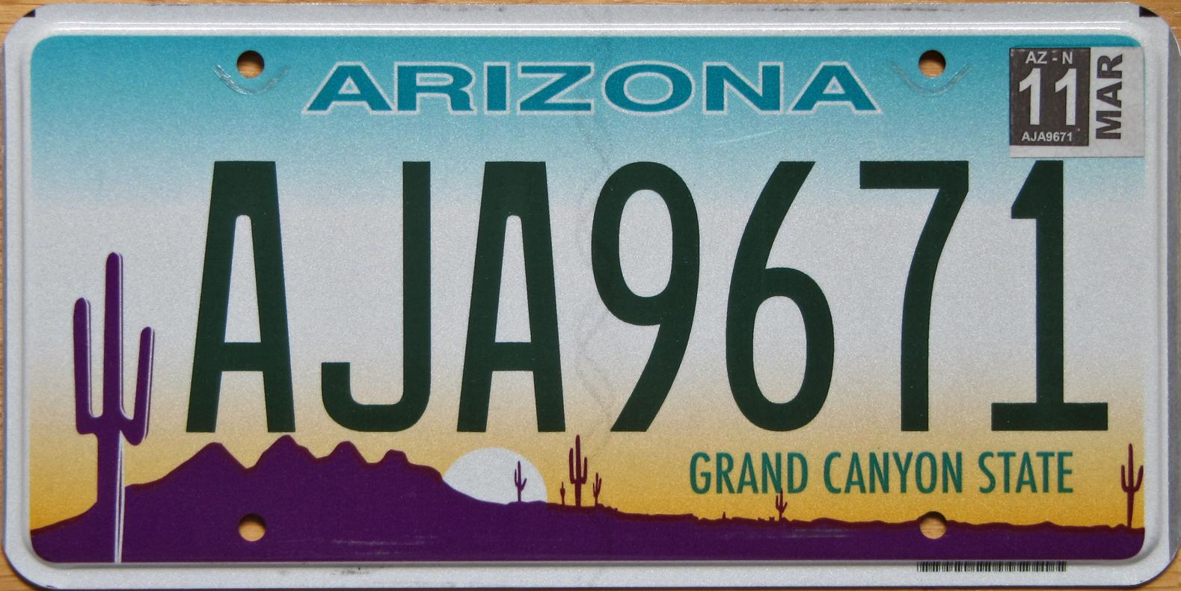
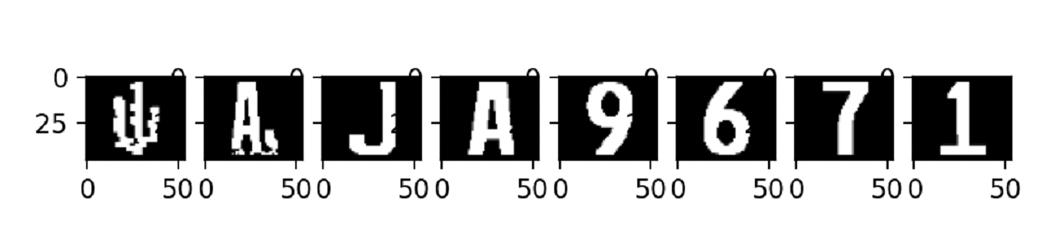
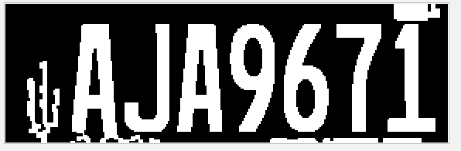
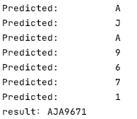
Character Segmentation and Recognition
Recognition result: # A J A 9 6 7 1

Slide 18
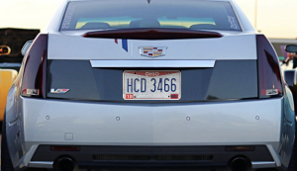
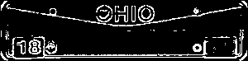
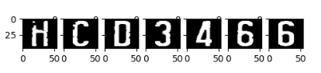
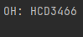
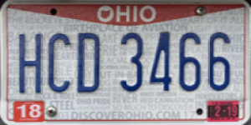

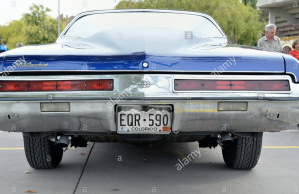
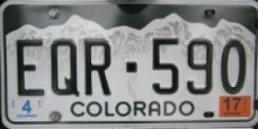
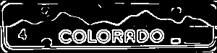
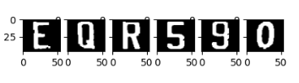
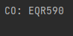

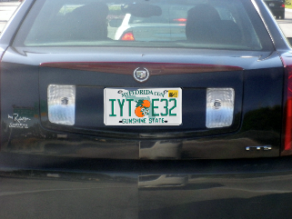
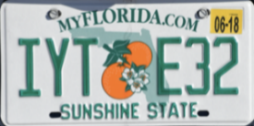
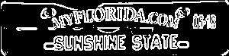
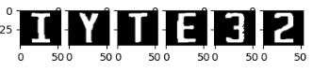
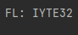







Some over all test results

Slide 19
Road Map
Dataset Manufacturing
Rectangle Detection & Plate Validation
State Recognition & Serial Extraction
Character Segmentation & Recognition
Future Work

Slide 20


Future Work
1. Improvement of universality
- More states (currently we only deal with the top-20 states with the most population)
- More patterns (people may have various customized plates and different versions)

Slide 21


Future Work
2. Various conditions
Currently the condition we assume/restrict is that the recognition happens at the entrance/exit of a parking lot.
- Not perfect angle
- Extreme weather conditions

Slide 22




Future Work
3. More robust plate detection
We may consider using YOLO Net in the future to directly detect plate in an image

Slide 23
Thank You!

